Slide 1
TE-MSC-MDT

Slide 2
11T_115
Reaction report
N. Bourcey
29/09/2015

Slide 3
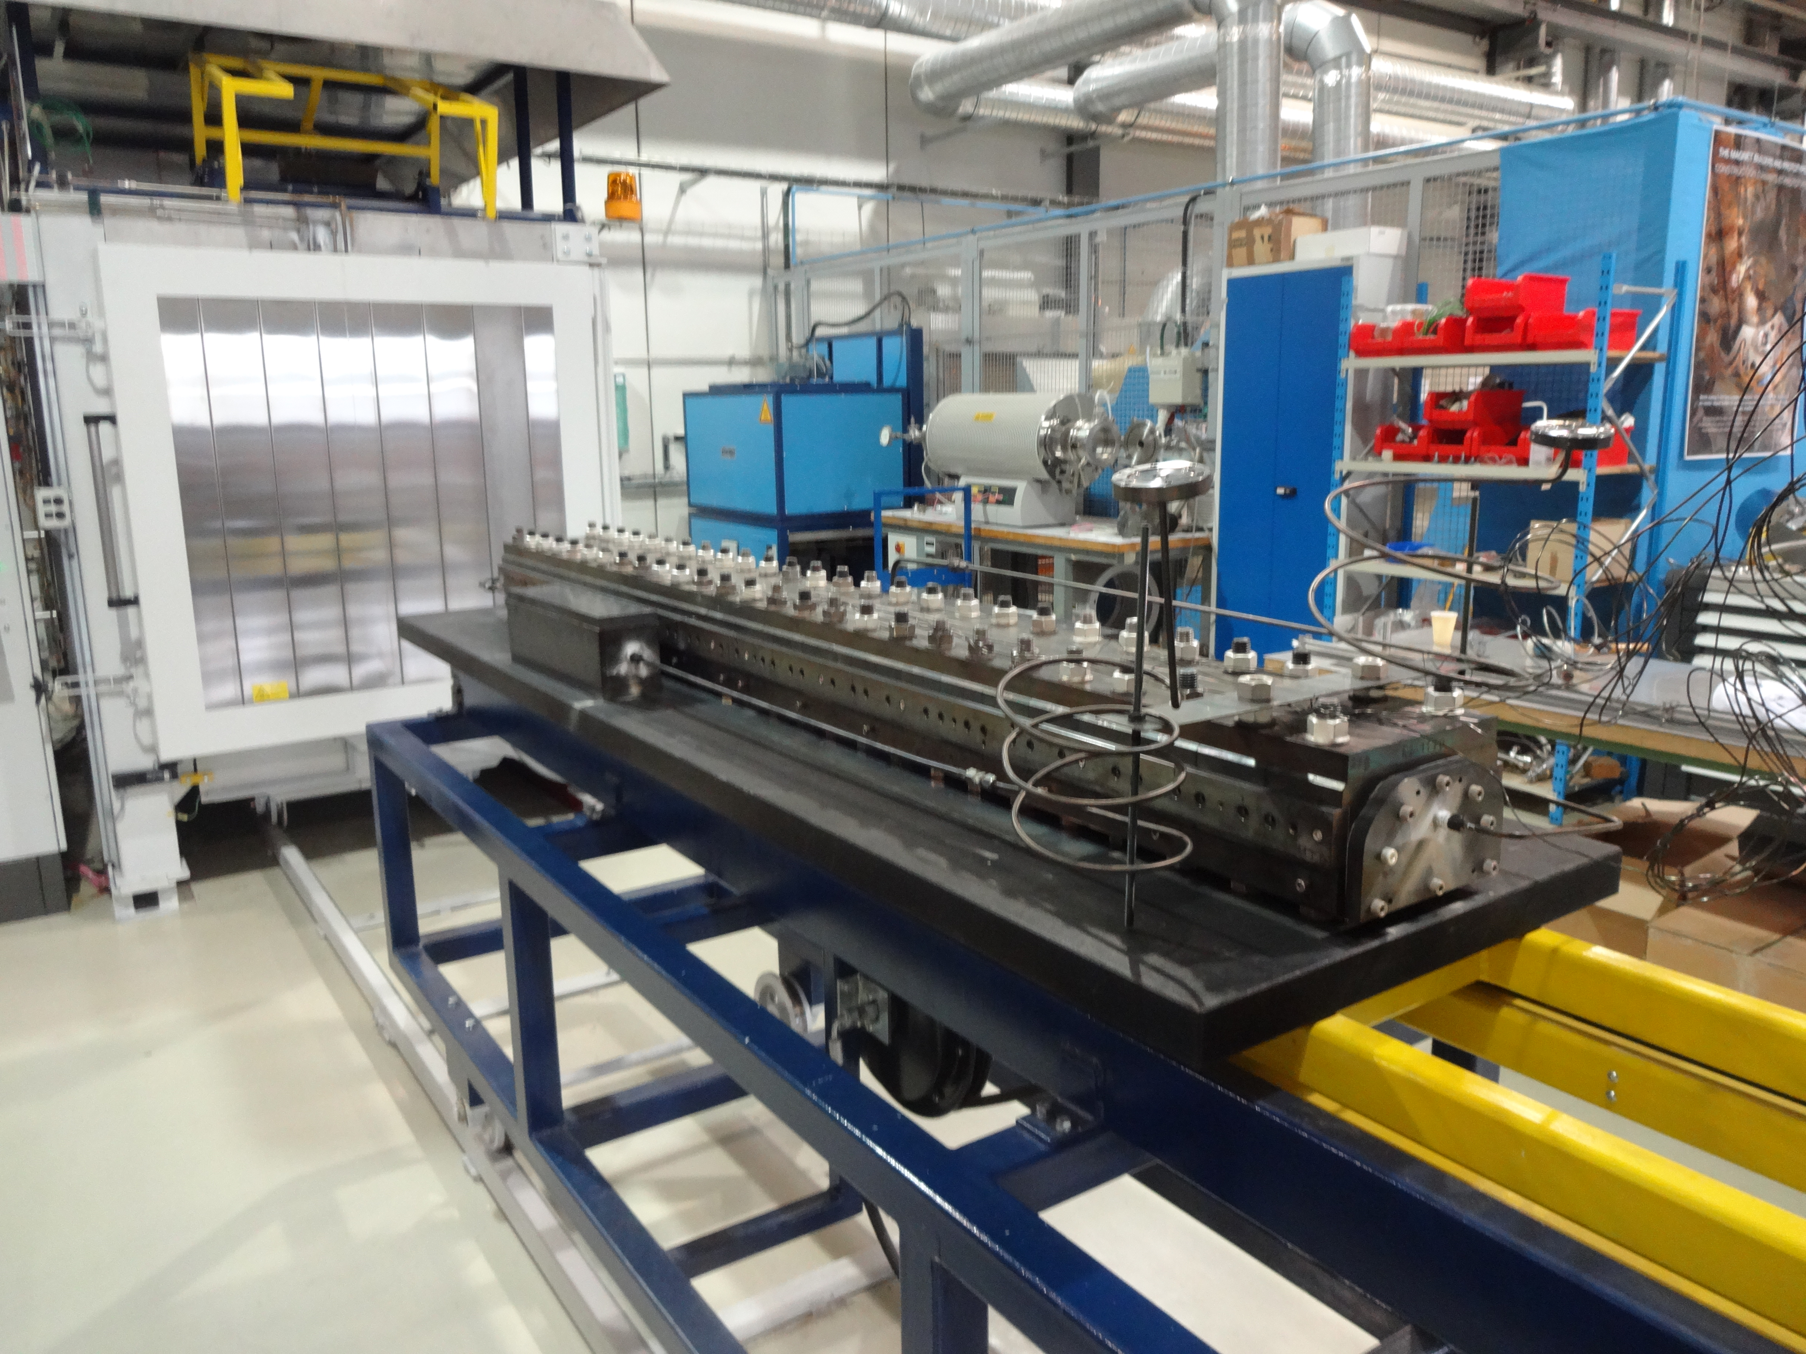
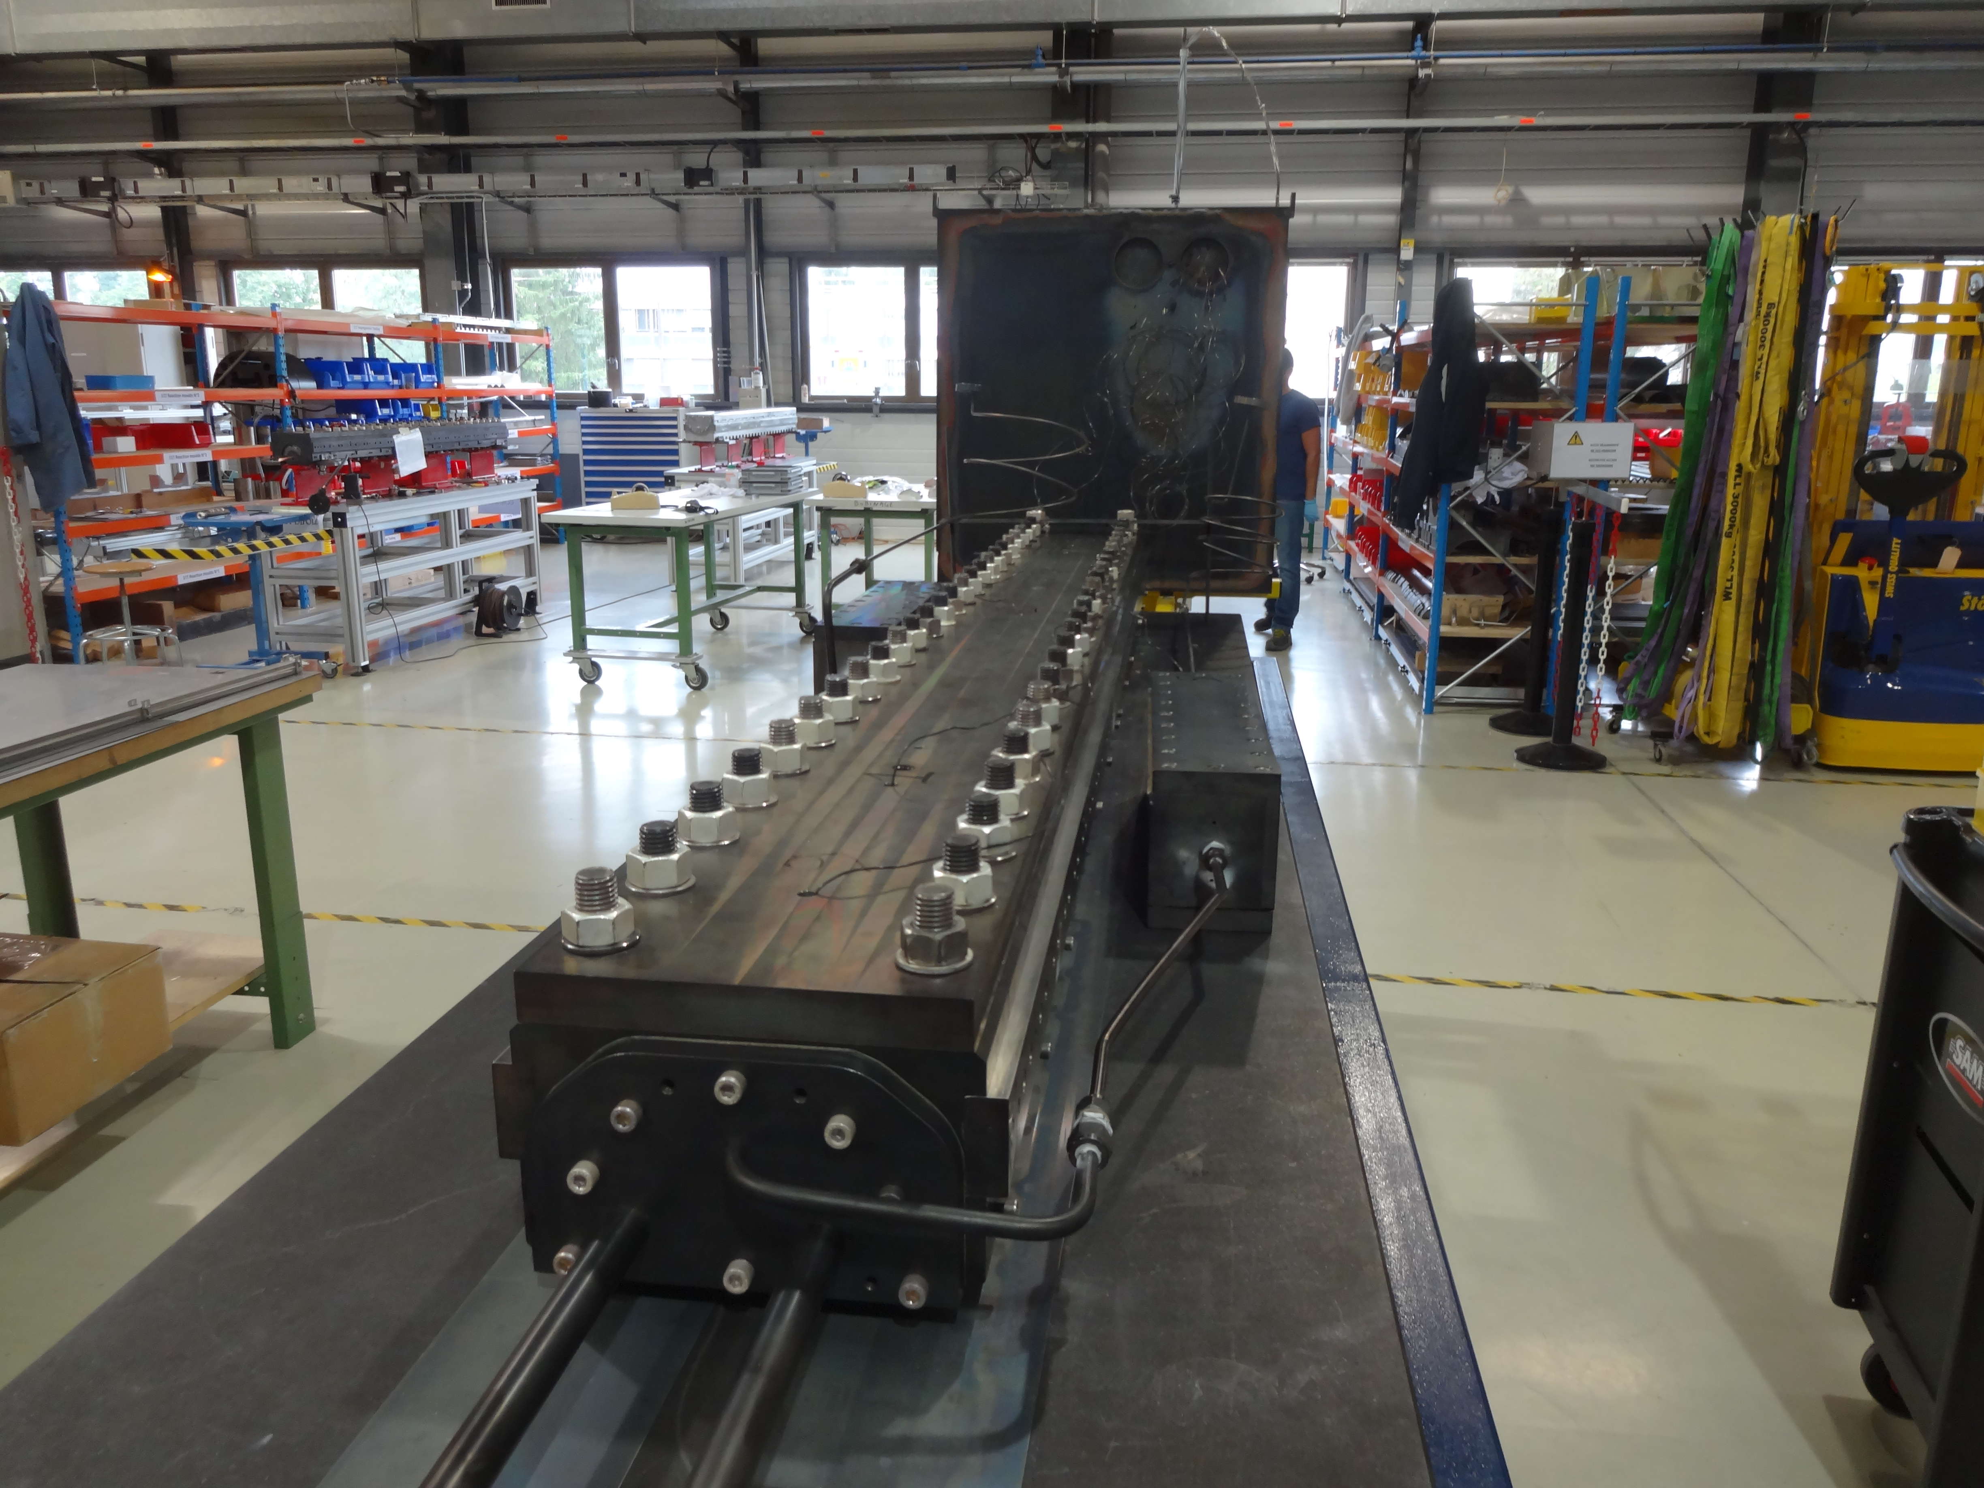
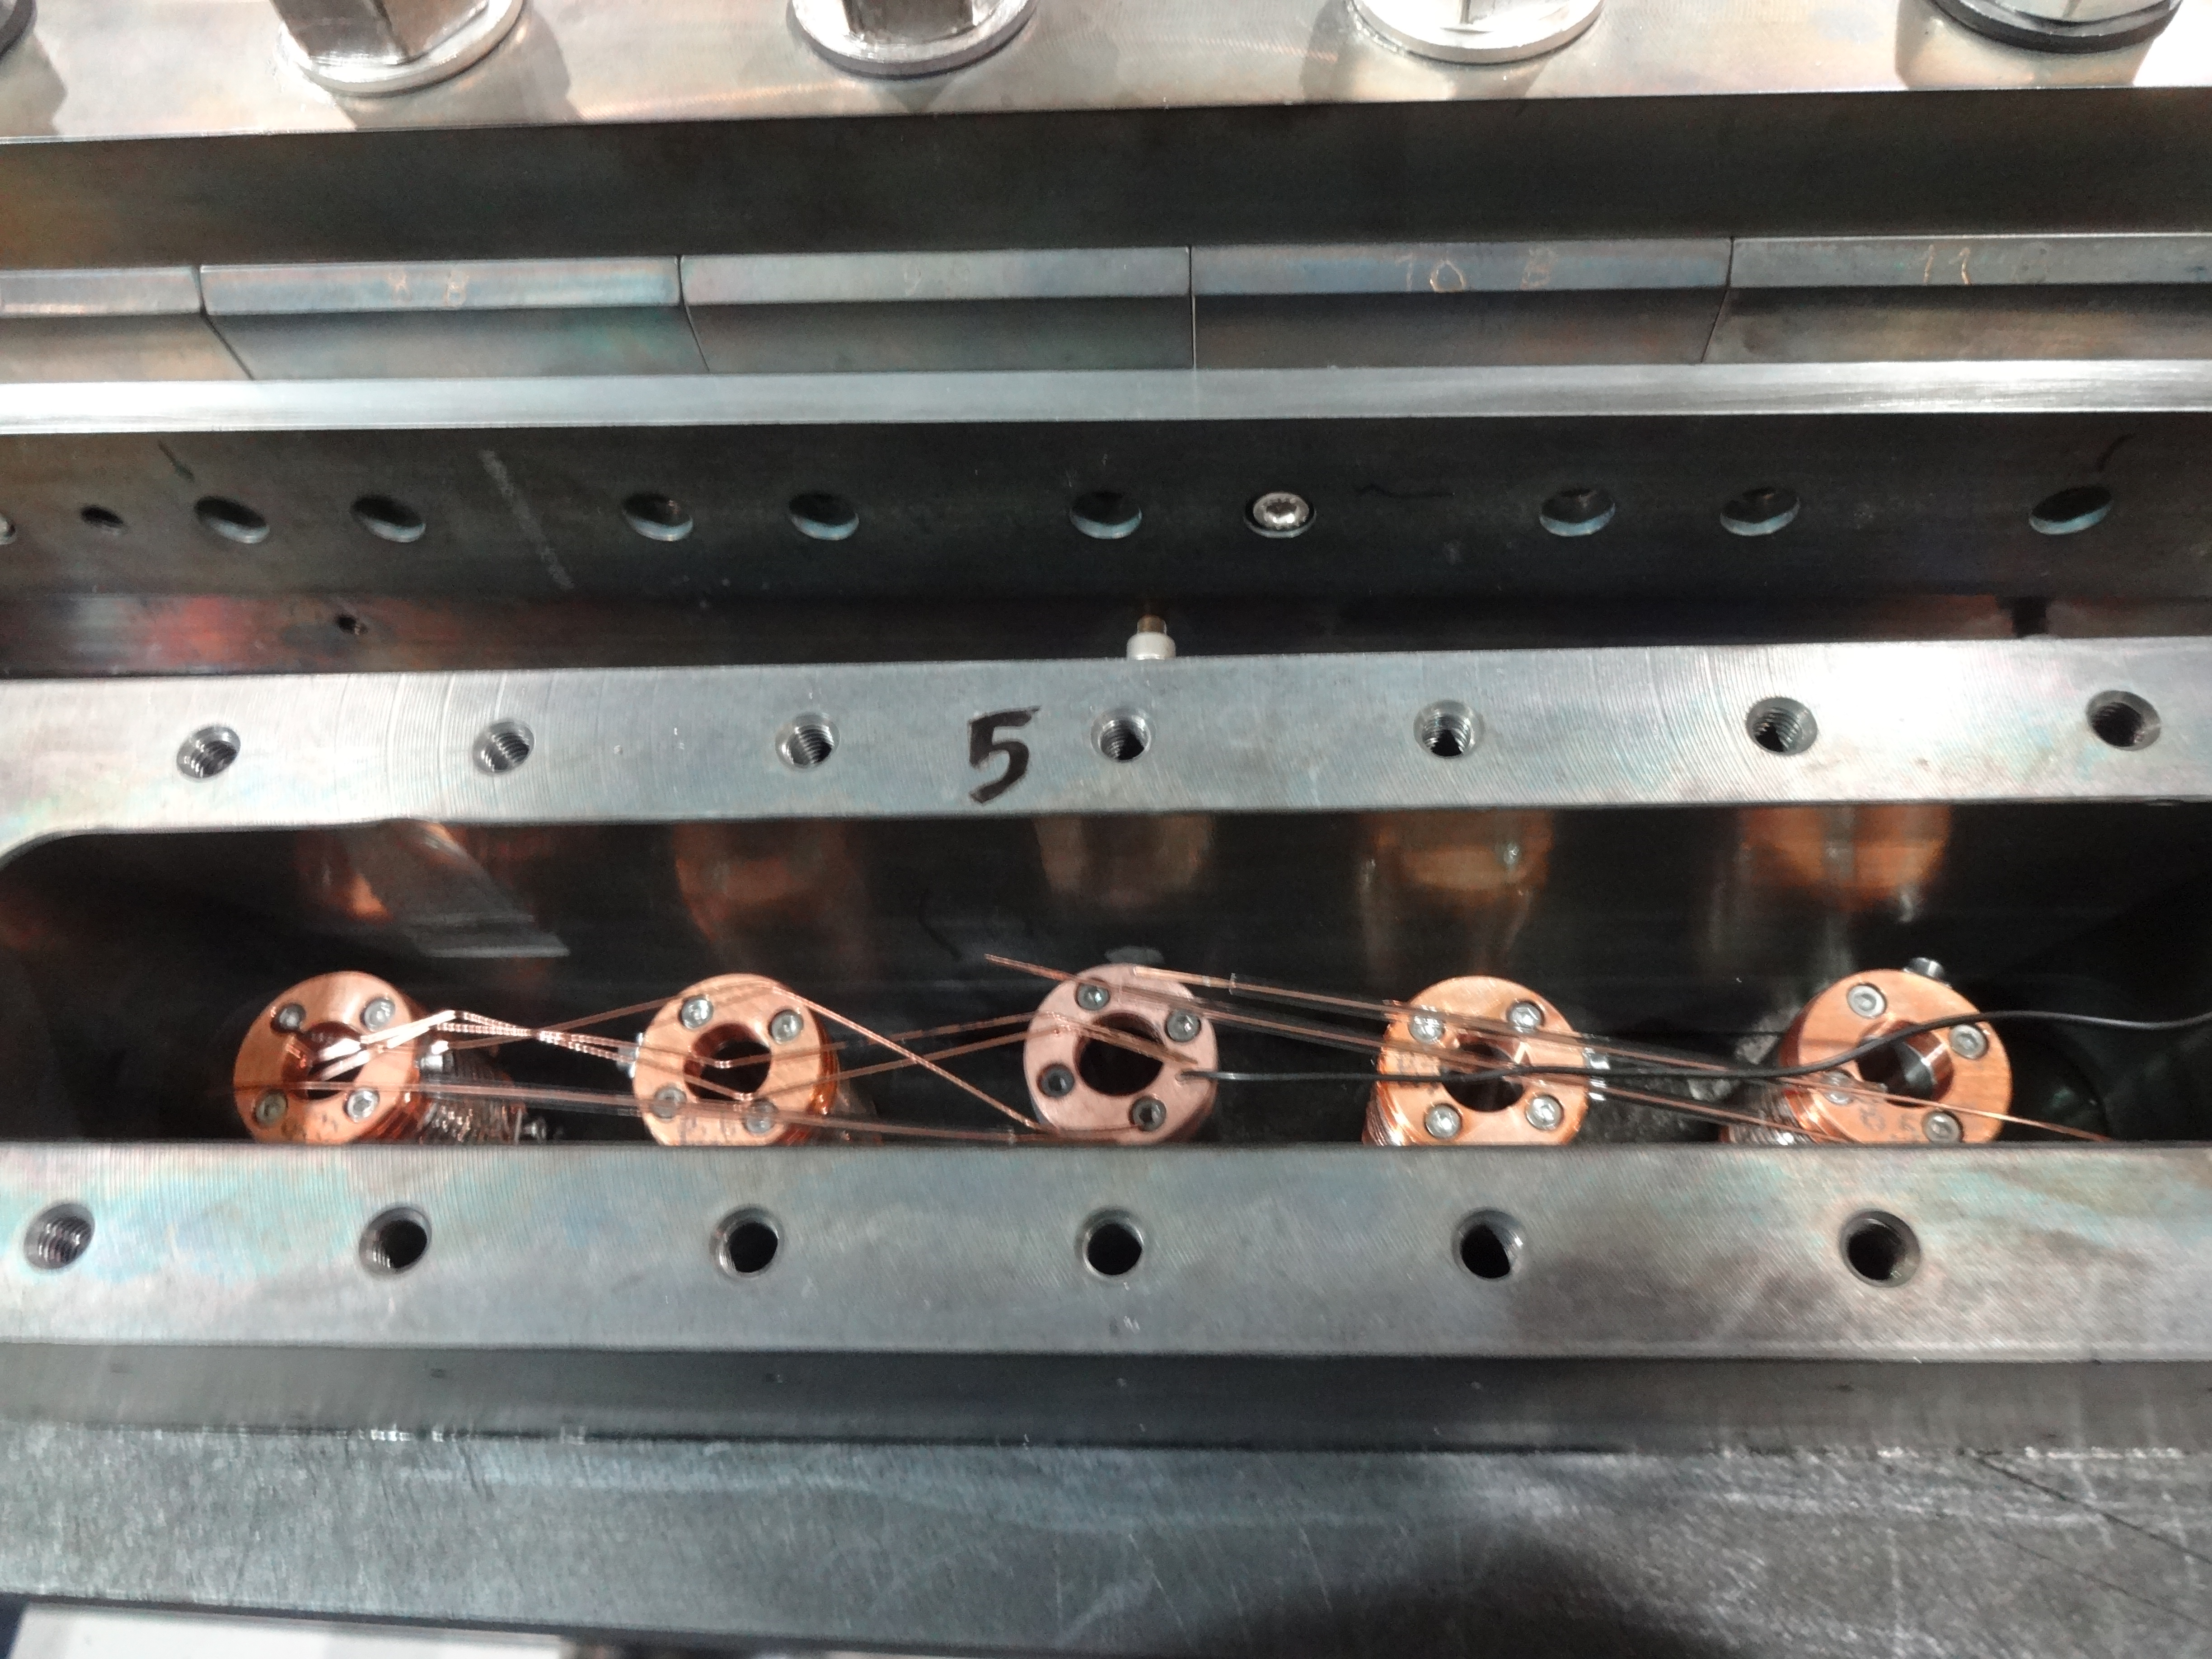
Preparation
Start date: 17/09/2015
End date: 28/09/2015
Cable ref: H15OC0186AF
Heat cycle :
Ramp 25°C/h, hold 72h/210°C
Ramp 50°C/h, hold 48h/400°C
Ramp 50°C/h, hold 50h/665°C

Slide 4
Reaction 11T-115 - Instrumentation layout
tc10
tc9
tc1
tc2
tc6
tc3
tc5
List of vamas and RRR samples (box before coil):
V1 – H15OC0186AF07E.001
V2 – H15OC0186AF07V.001
V3 – H15OC0186AF13E.001
V4 – H15OC0186AF13V.001
6 RRR samples (3 virgin + 3 extracted)
List of vamas and RRR samples (box after coil):
V7 – H15OC0186AF09V.001
V8 – H15OC0186AF09E.001

Slide 5
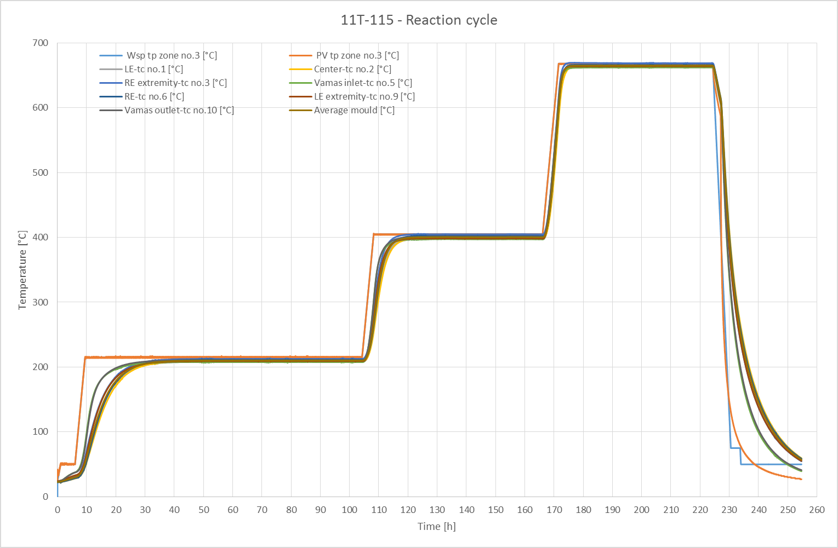

Slide 6
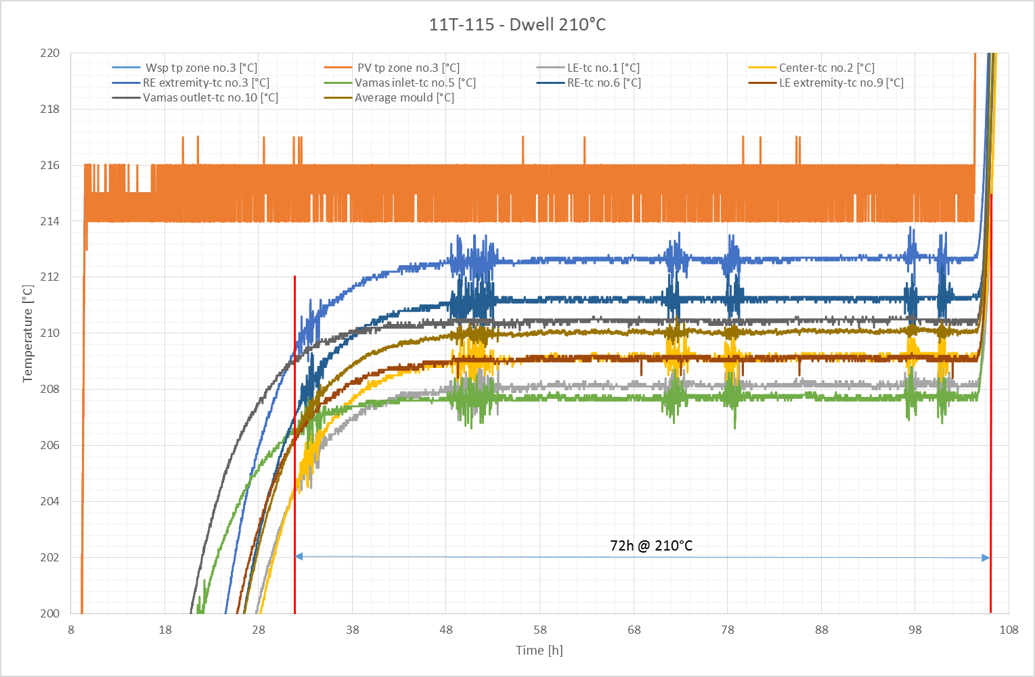

Slide 7
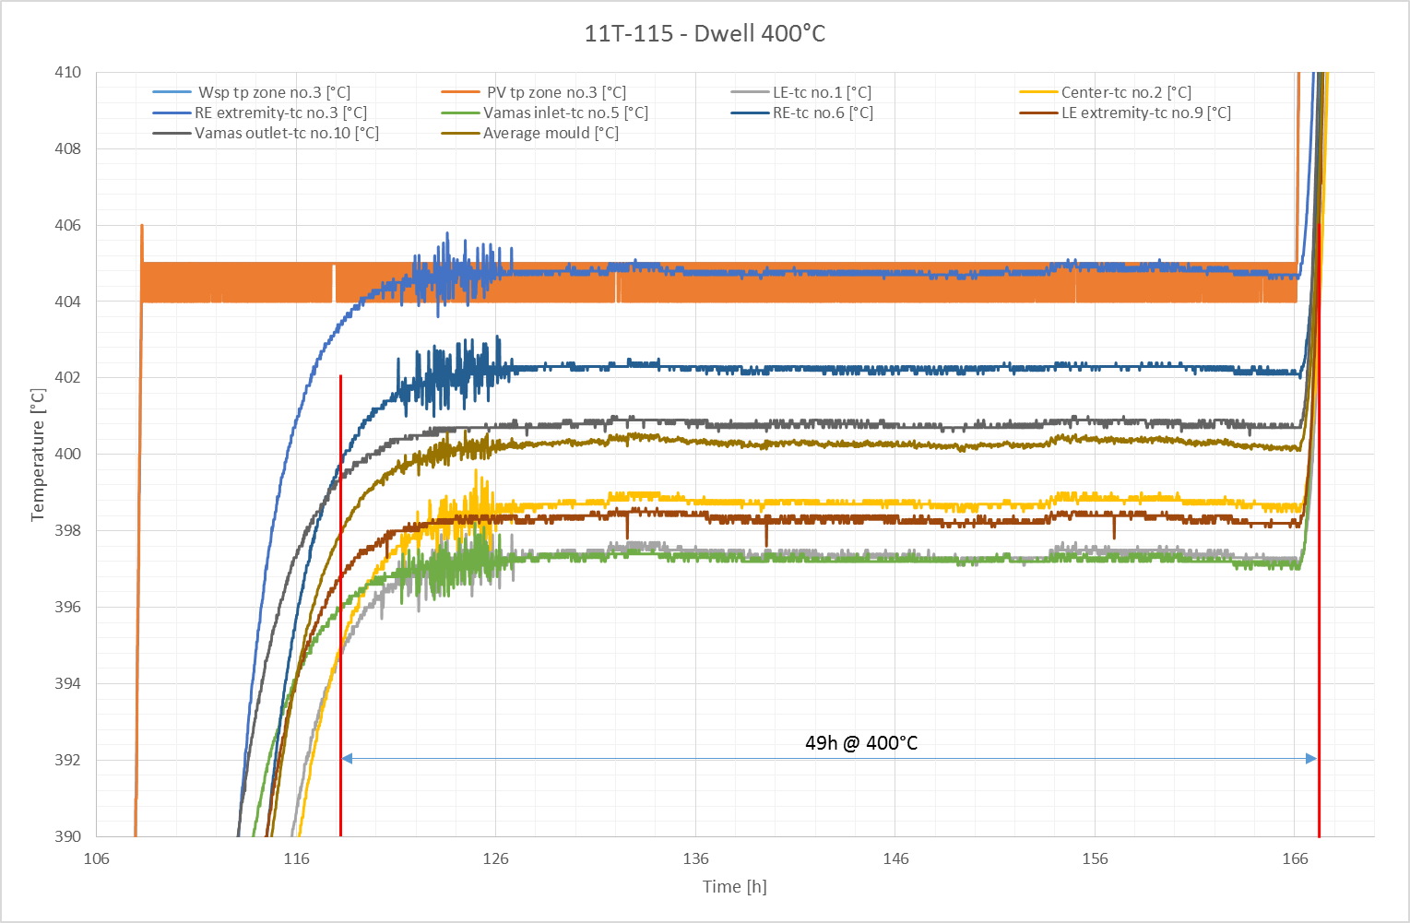

Slide 8
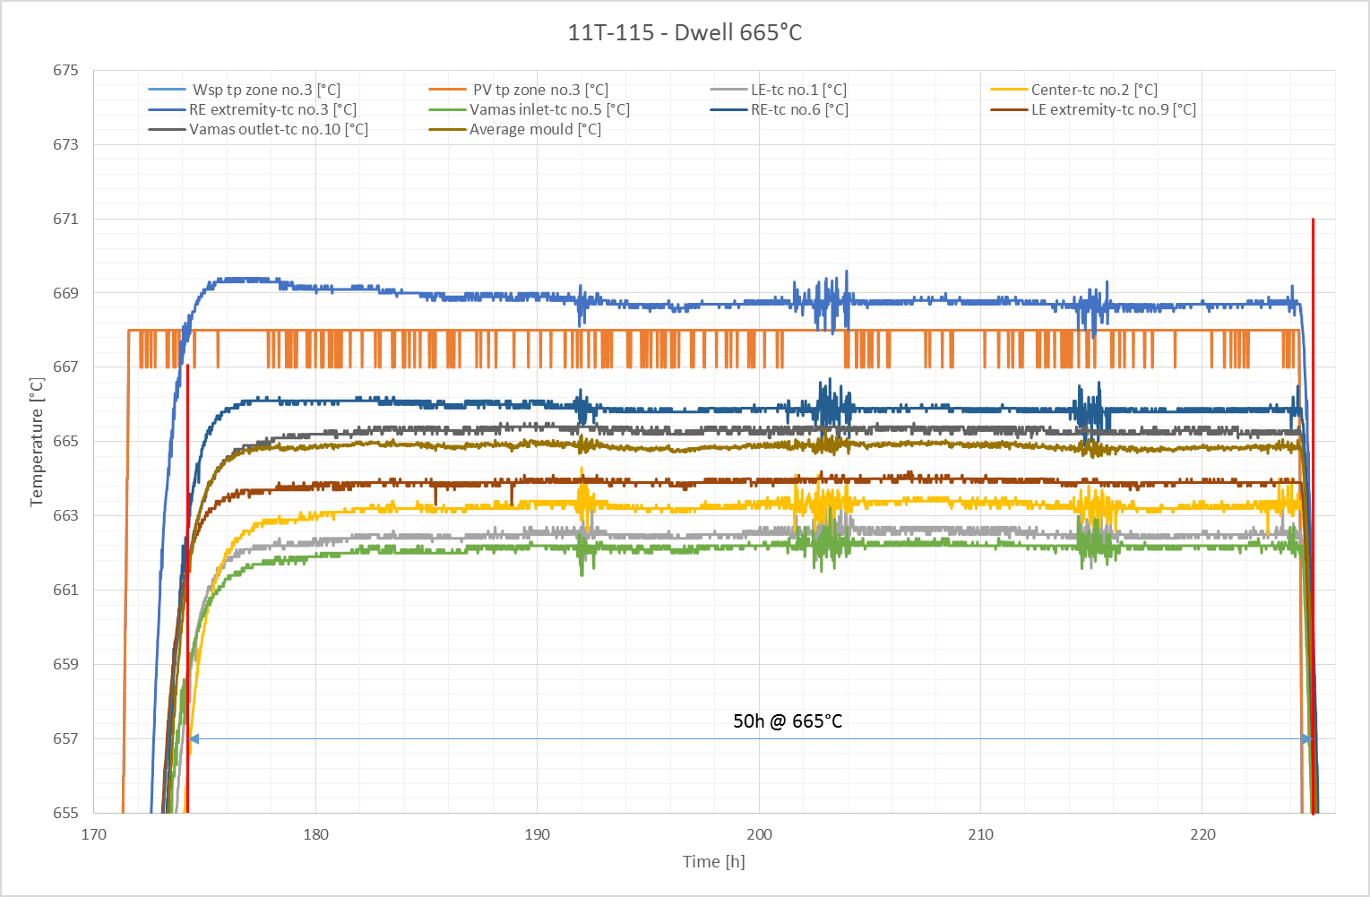

Slide 9
Remarks
No fan
No O2 content measurement

Slide 10
TE-MSC-MDT

